Slide 1


澳洲U58QG7L
产品策划组
长虹·美菱国际区

Slide 2
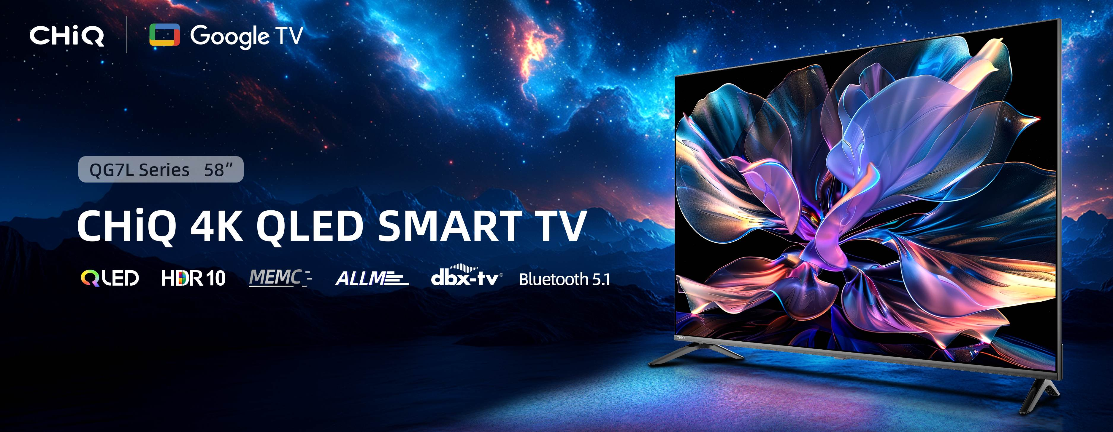
banner
长虹·美菱国际区
CHiQ | Google TV
QG7L Series 58”
CHiQ 4K QLED TV
QLED
Dolby Atmos
MEMC
Metallic Frameless
ALLM
Bluetooth 5.1

Slide 3
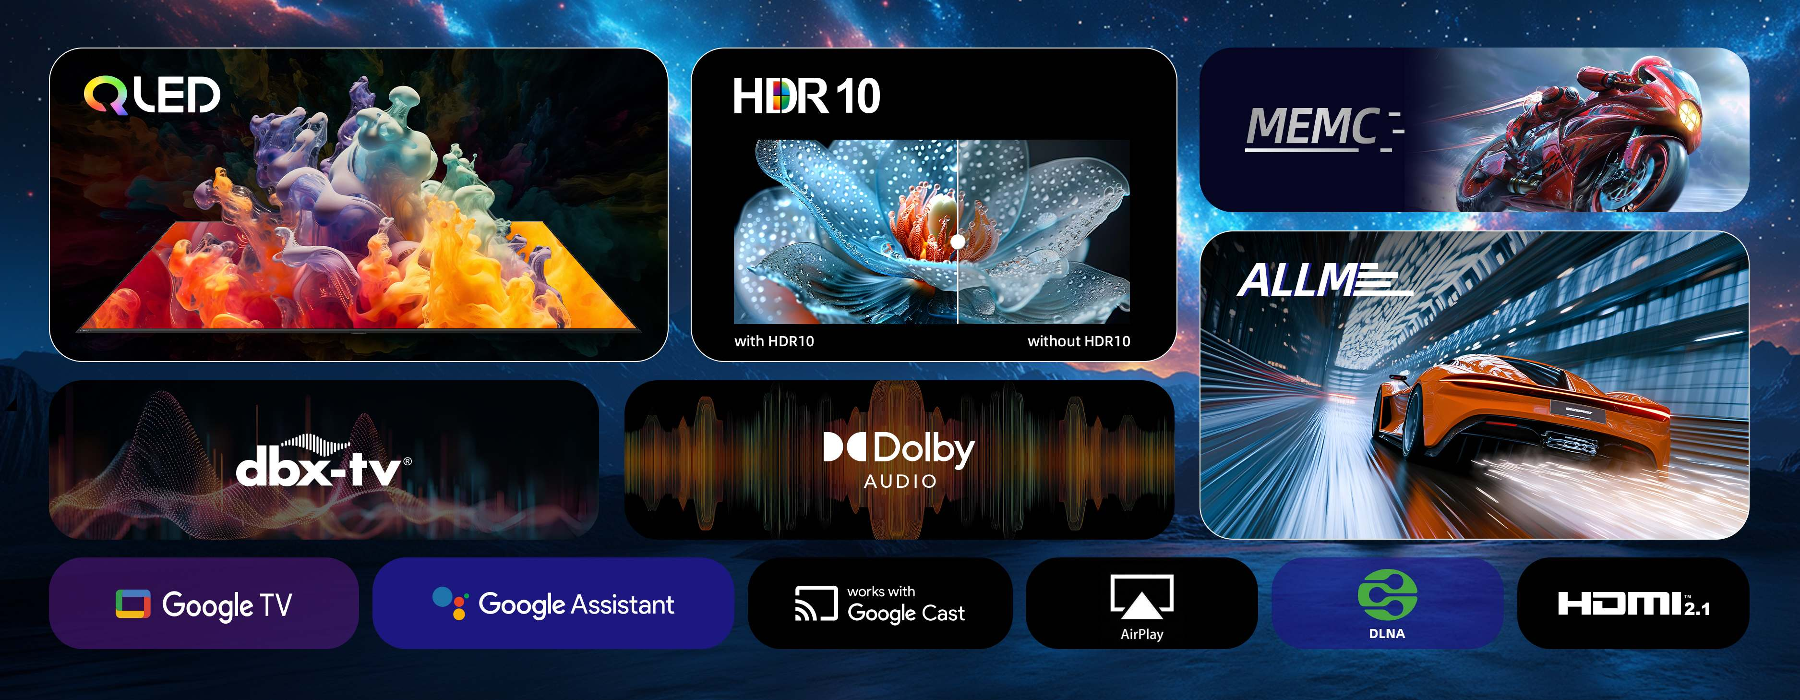
卖点墙
长虹·美菱国际区
QLED
（色彩迸发屏幕）
HDR10
（HDR有无对比）
MEMC
DBX-TV
（突出音浪效果）
Dolby Audio
（家庭影院图）
ALLM
（游戏场景）
Google TV
Google Assistant
Google Cast
AirPlay
DLNA
HDMI2.1

Slide 4
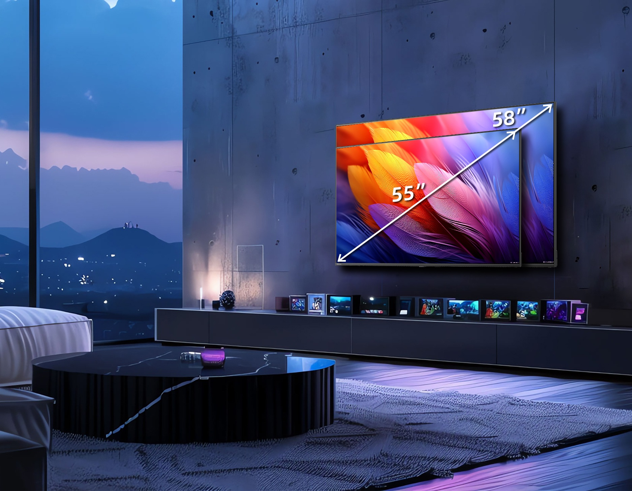
新增-58比55大三寸
长虹·美菱国际区
Better immersion for viewing
The bigger screen it is, the more immersive you will feel.

Slide 5
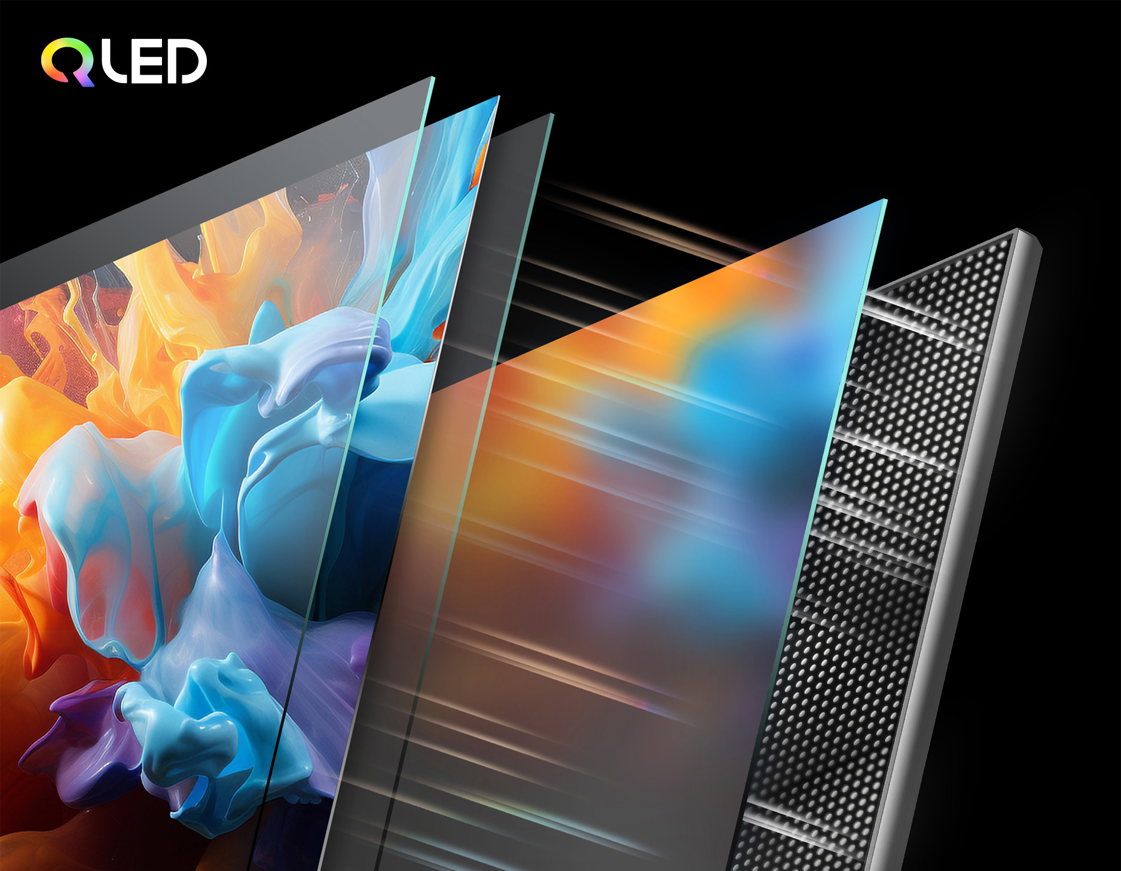
QLED
长虹·美菱国际区
Take a leap into the lifelike Quantum Dot world
The backlight LEDs emit light with different wavelengths and colours through the special quantum dot material, achieving a wider colour gamut for a richer and more vibrant visuals.
背光 LED 通过特殊的量子点材料发出不同波长和颜色的光，从而实现更宽广的色域，带来更丰富、更生动的视觉效果。

Slide 6
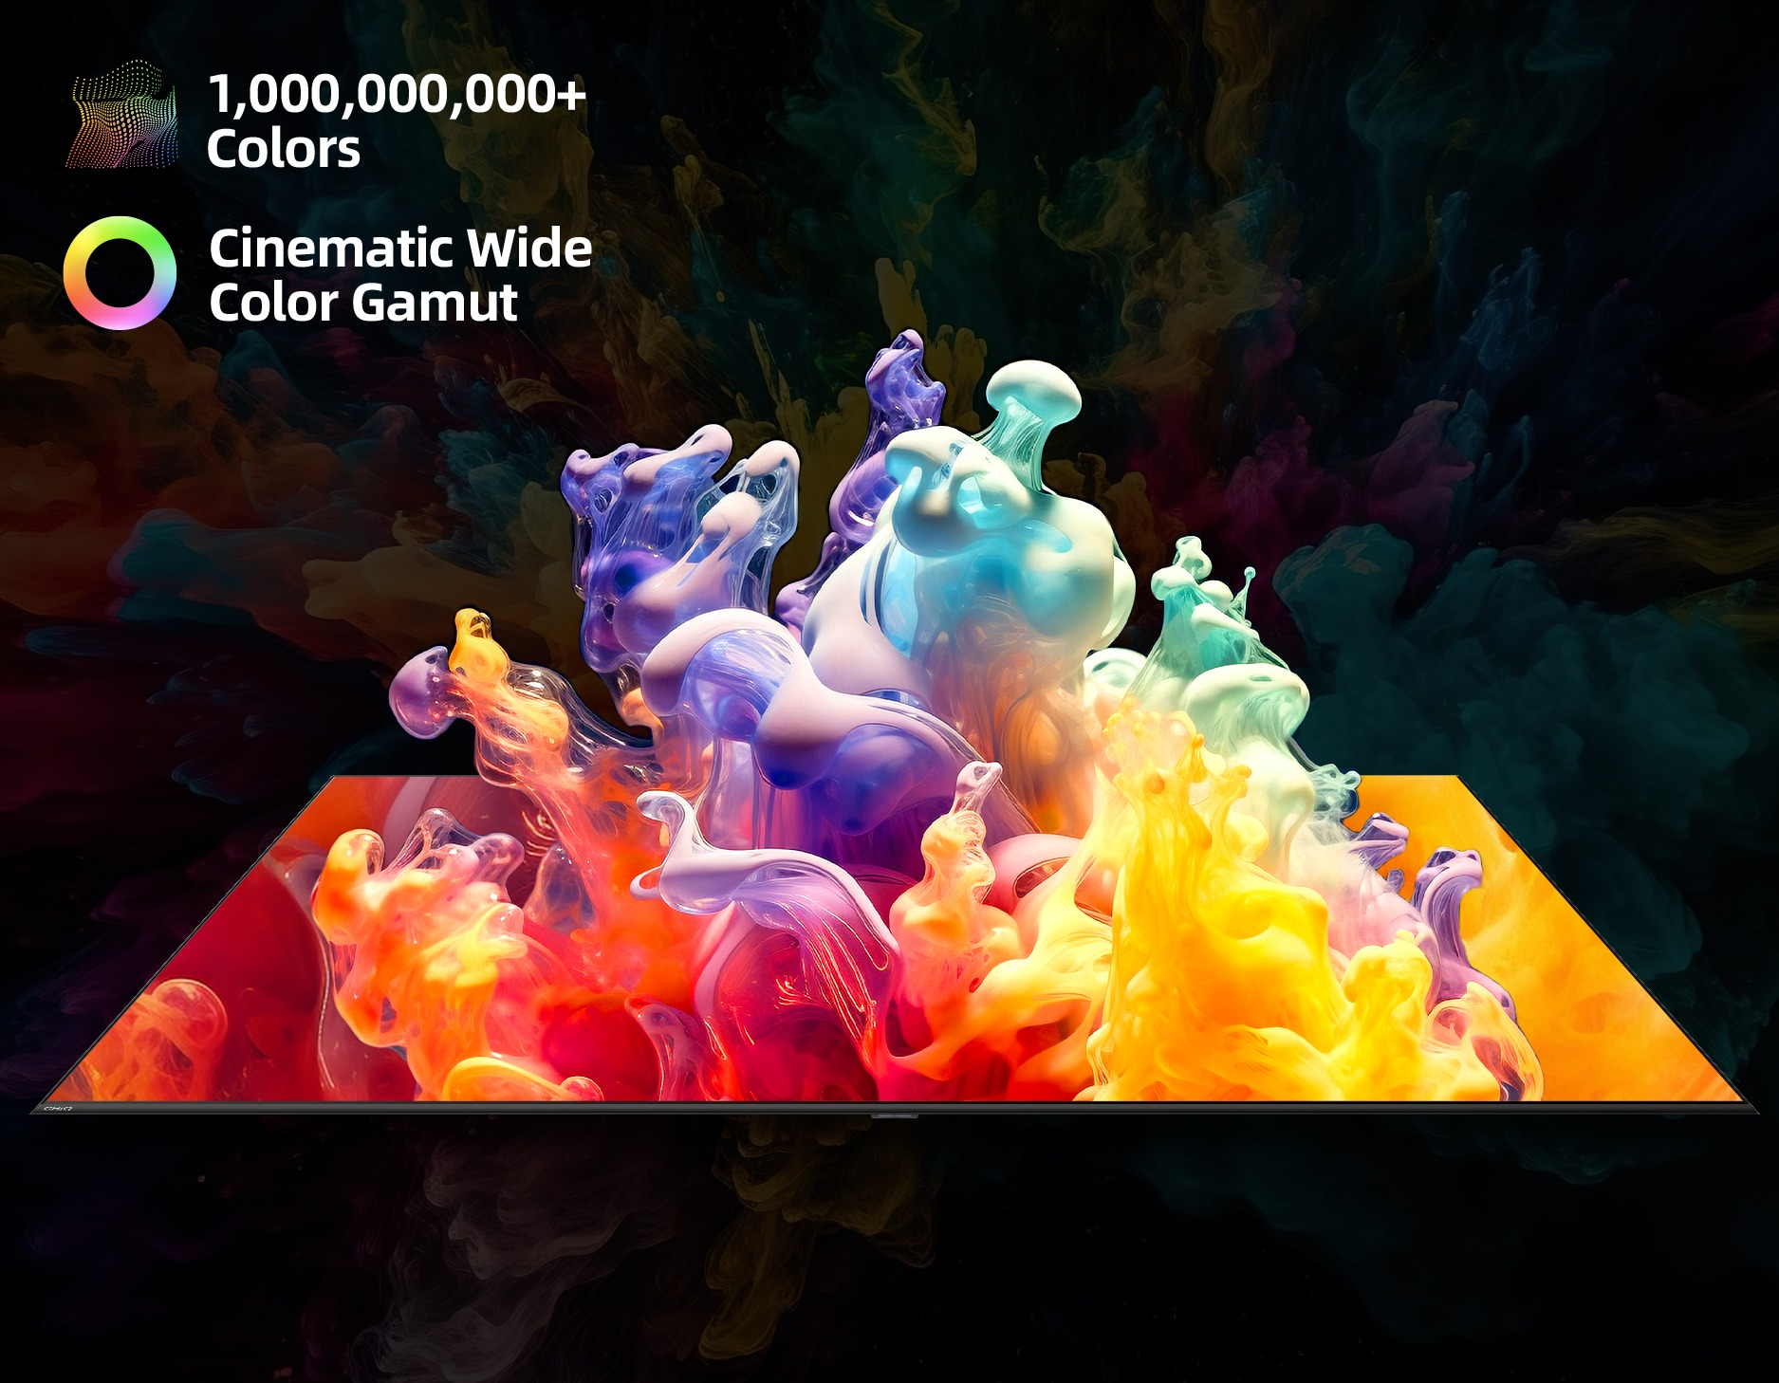
色彩
长虹·美菱国际区
Vivid visuals, Lifelike colours
CHiQ Quantum Dot technology delivers rich colours and the screen presents over 1 billion shades. Vivid and smooth colour transitions bring images to life.

Slide 7
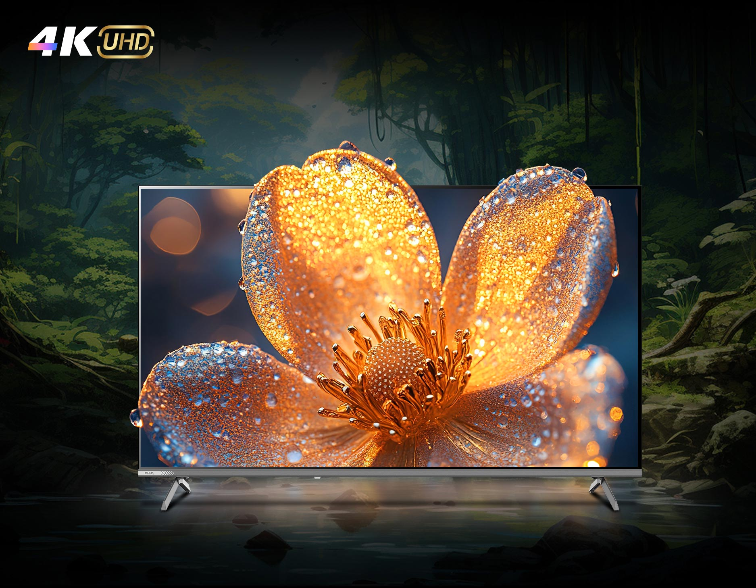
4K UHD
长虹·美菱国际区
Crisp and Clear Details
Experience rich details with dazzling 4K resolution, nearly 8.3 million on-screen pixels for impeccable precision.

Slide 8
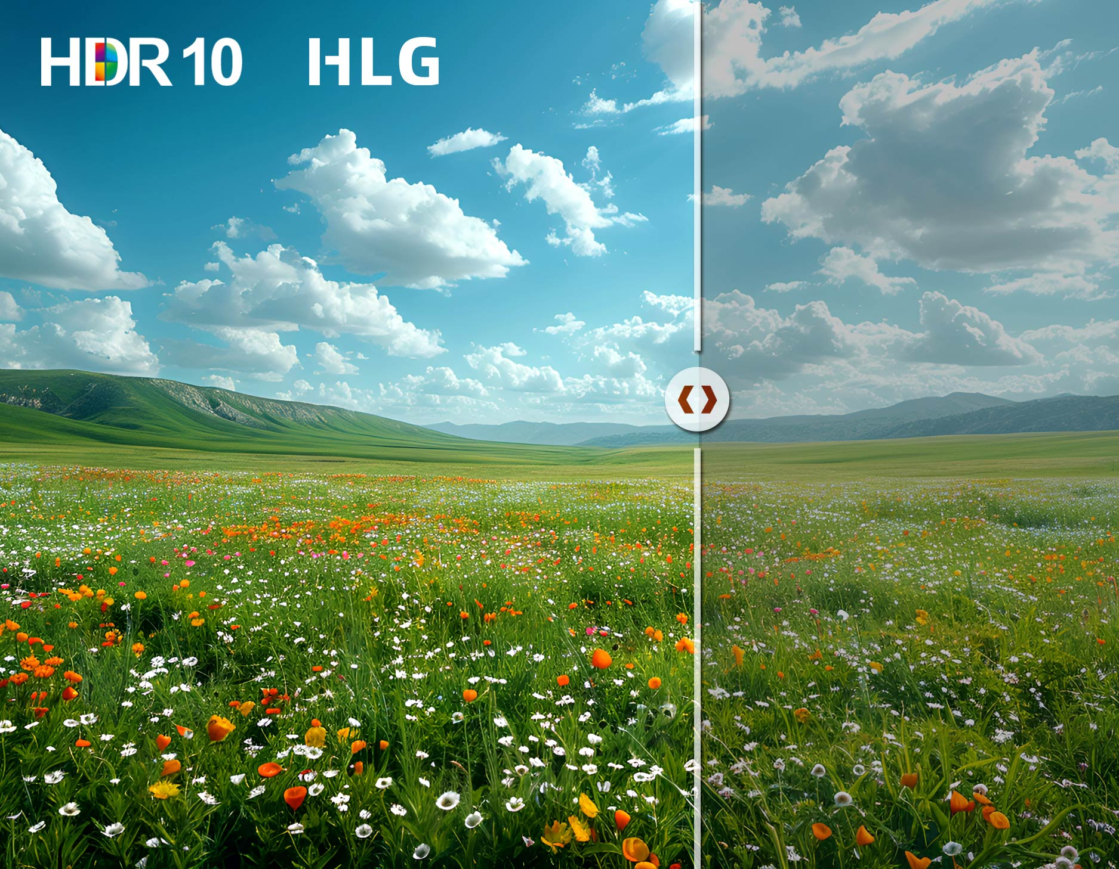
HDR
长虹·美菱国际区
See Details in Detail
Your favorite HDR contents spring to life with enhanced contrast and exceptional shadow details. The sun shines brighter, and the clouds are more richly layered.
您喜爱的 HDR 内容栩栩如生，对比度增强，阴影细节出众。阳光更加灿烂，云彩层次更加丰富。

Slide 9
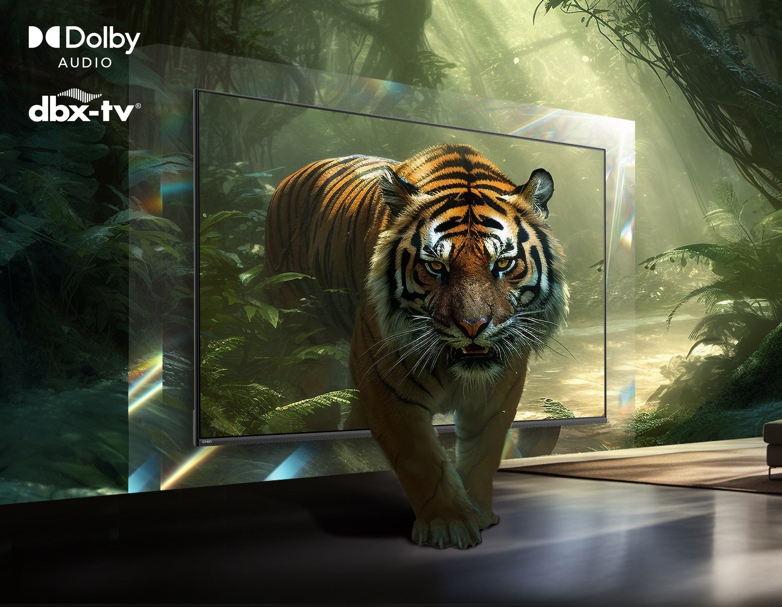
观影
长虹·美菱国际区
Immerse Youself in the Plot
CHiQ电视通过杜比专业认证，他以令人难以置信的清晰度和绝佳的细节，让你沉浸在每一个场景中。4K分辨率、Dolby、dbx-tv等多种视听技术相结合，以清晰的细节、生动的色彩、丰富的立体声将您带入故事之中。
Best-in-class ultra-HD visual, richer details and spatial audio processing. Revealing depth, clarity and details for a more immersive cinematic experience.

Slide 10
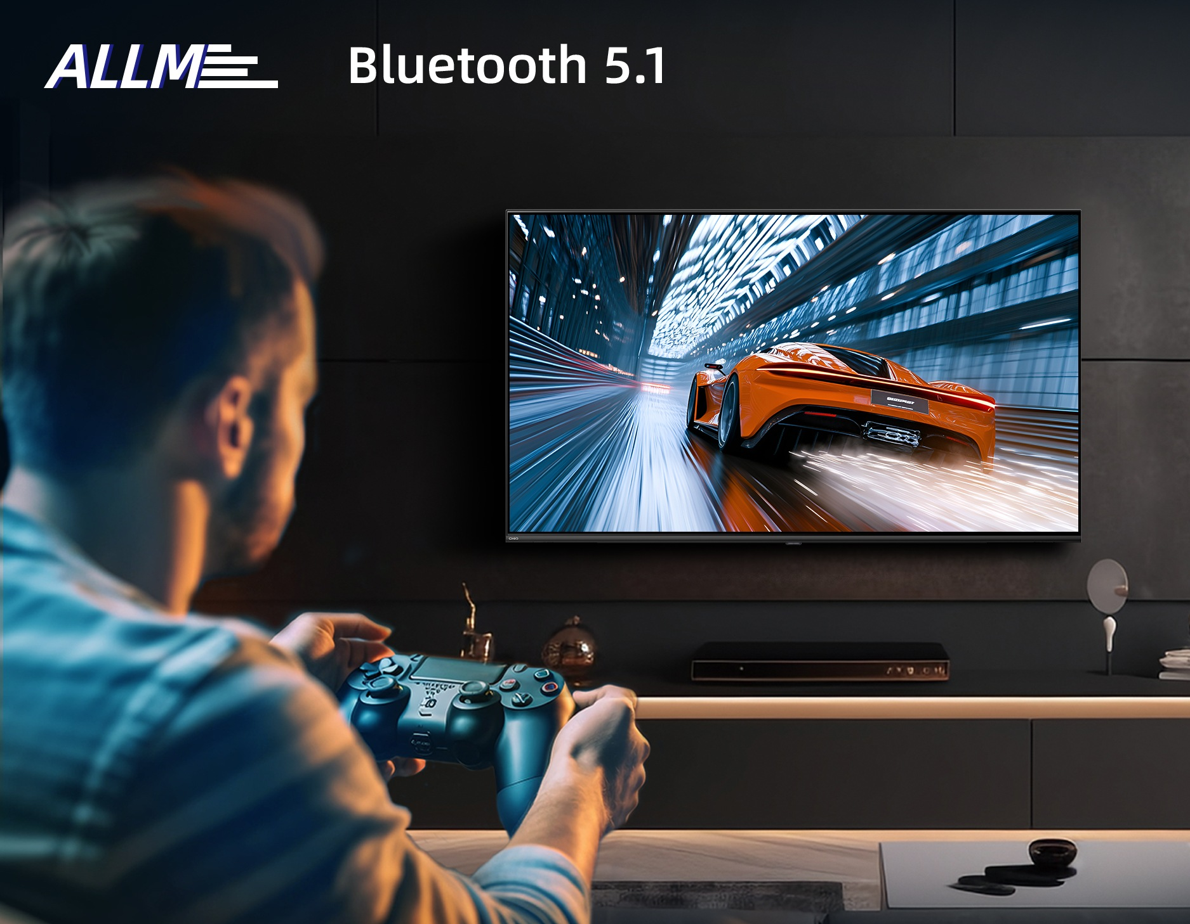
游戏
长虹·美菱国际区
Smooth and Clear Motion
通过所有的游戏就绪功能，获得最佳游戏体验。此外，BT5.1支持多种无线设备无缝连接，连接你的游戏手柄或耳机，享受沉浸式游戏体验，避免复杂的布线
Get the best gaming experience with all the game-ready features. Bluetooth 5.1 supports seamless connectivity for wireless devices. Connect your gamepad or headset and enjoy an immersive gaming experience without complicated wiring.

Slide 11
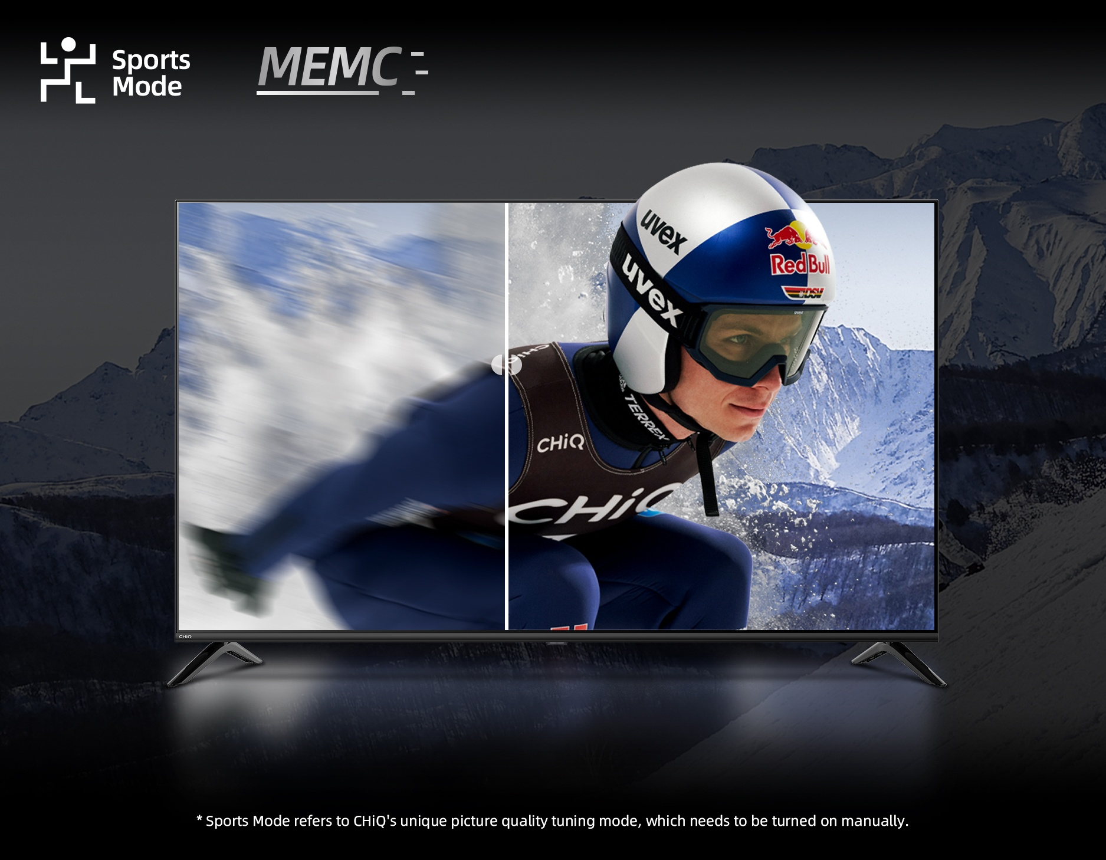
运动赛事
长虹·美菱国际区
Never Miss the Details
观看您喜爱的精彩体育比赛时，享受清晰流畅的运动画面。CHiQ MQN9 系列插入过渡帧，降低噪点，调整画质，带来无缝观看体验。
Enjoy a crystal-clear and fluid motion when watching your favorite exciting sports. CHiQ MQN9 series insert transitional frames, adjust images for a seamless viewing experience.

Slide 12
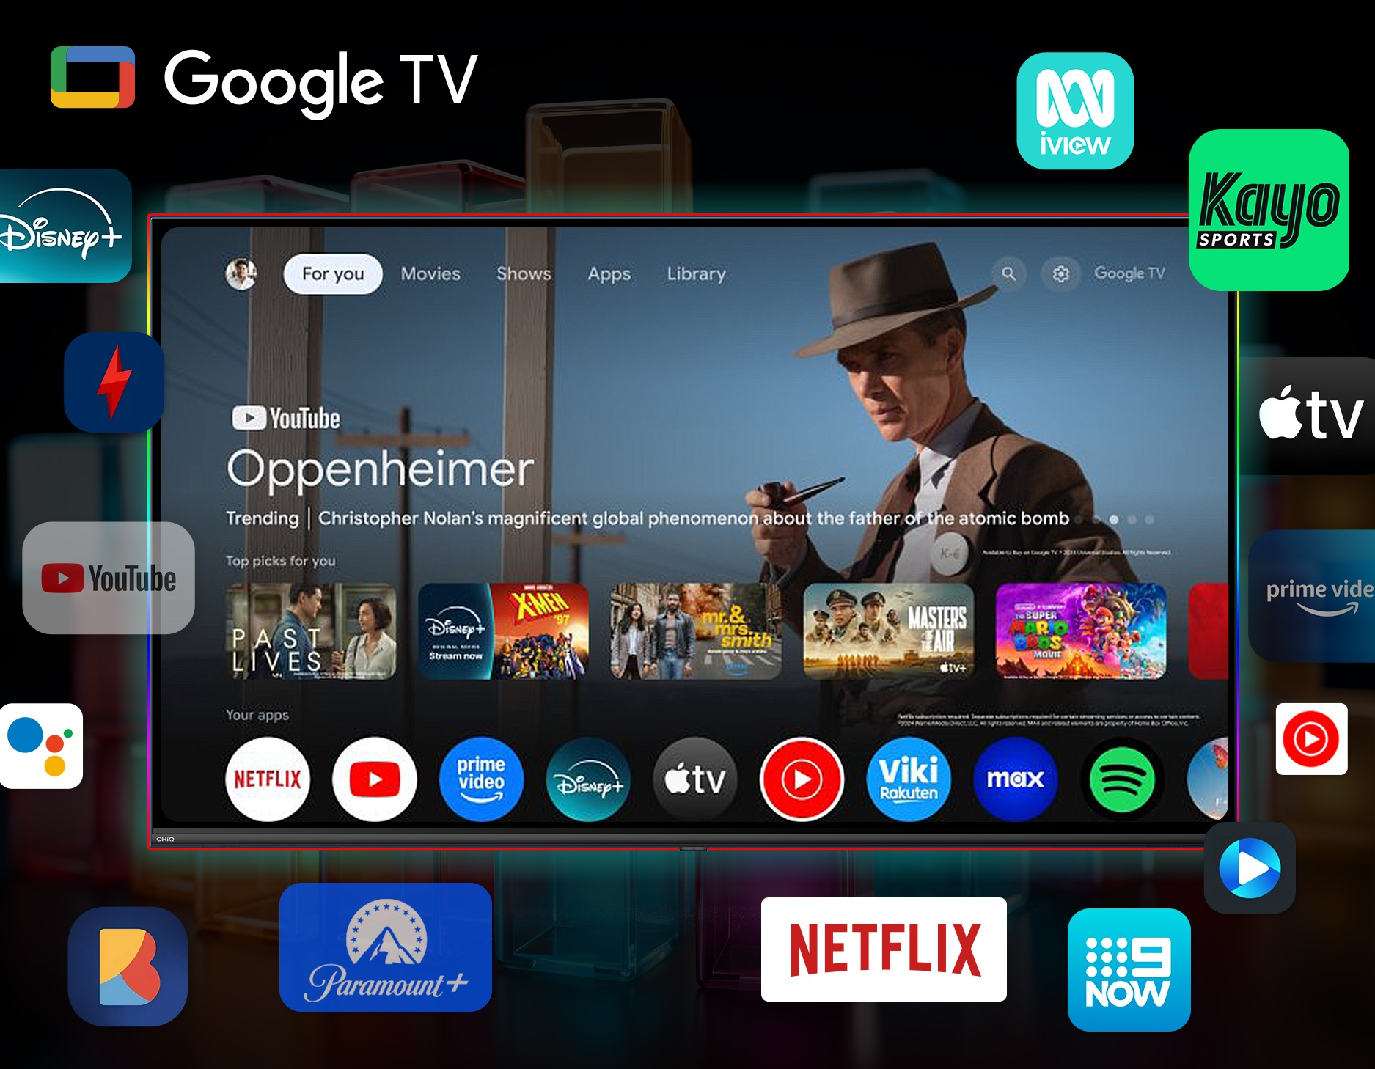
谷歌系统大图
长虹·美菱国际区
Everything you stream, all on one screen
Easily access to more than 10,000 apps, industry-leading privacy and security, and amazing features for finding your favorite contents faster.

Slide 13
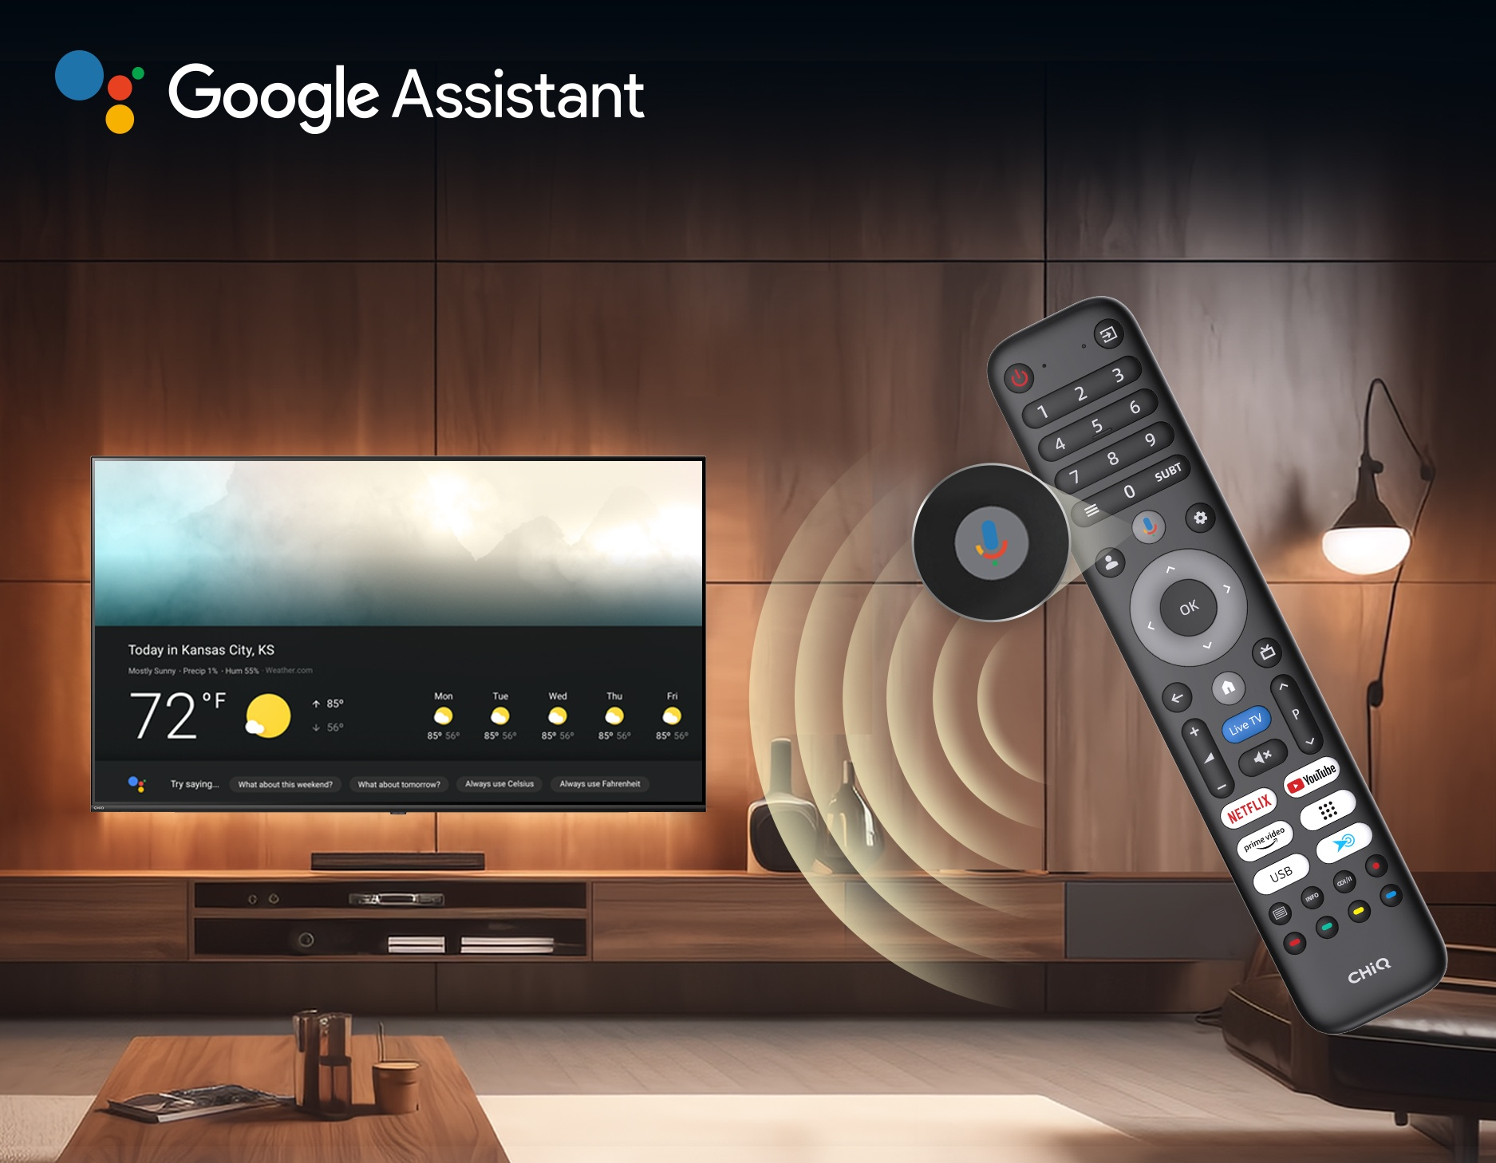
语音控制
长虹·美菱国际区
Intelligent Voice Control
Control your Google TV just with your voice. Greatly improving the convenience of user operation and the intelligent experience.
告别无休止的滚动。只需语音即可轻松控制电视。大大提高用户操作的便利性和智能体验。

Slide 14
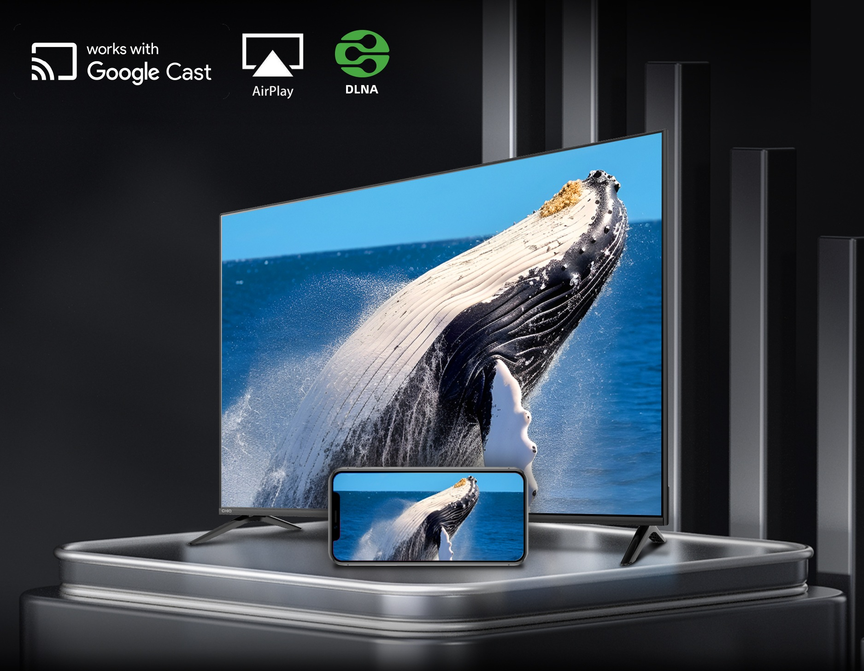
投屏
长虹·美菱国际区
Enjoy More with Bigger Screen
Cast your favourite videos, games, apps or files from your PC, laptop or mobile devices seamlessly to your TV.
将您最喜爱的视频、游戏、应用程序或文件从 PC、笔记本电脑或移动设备无缝地投射到电视上。

Slide 15
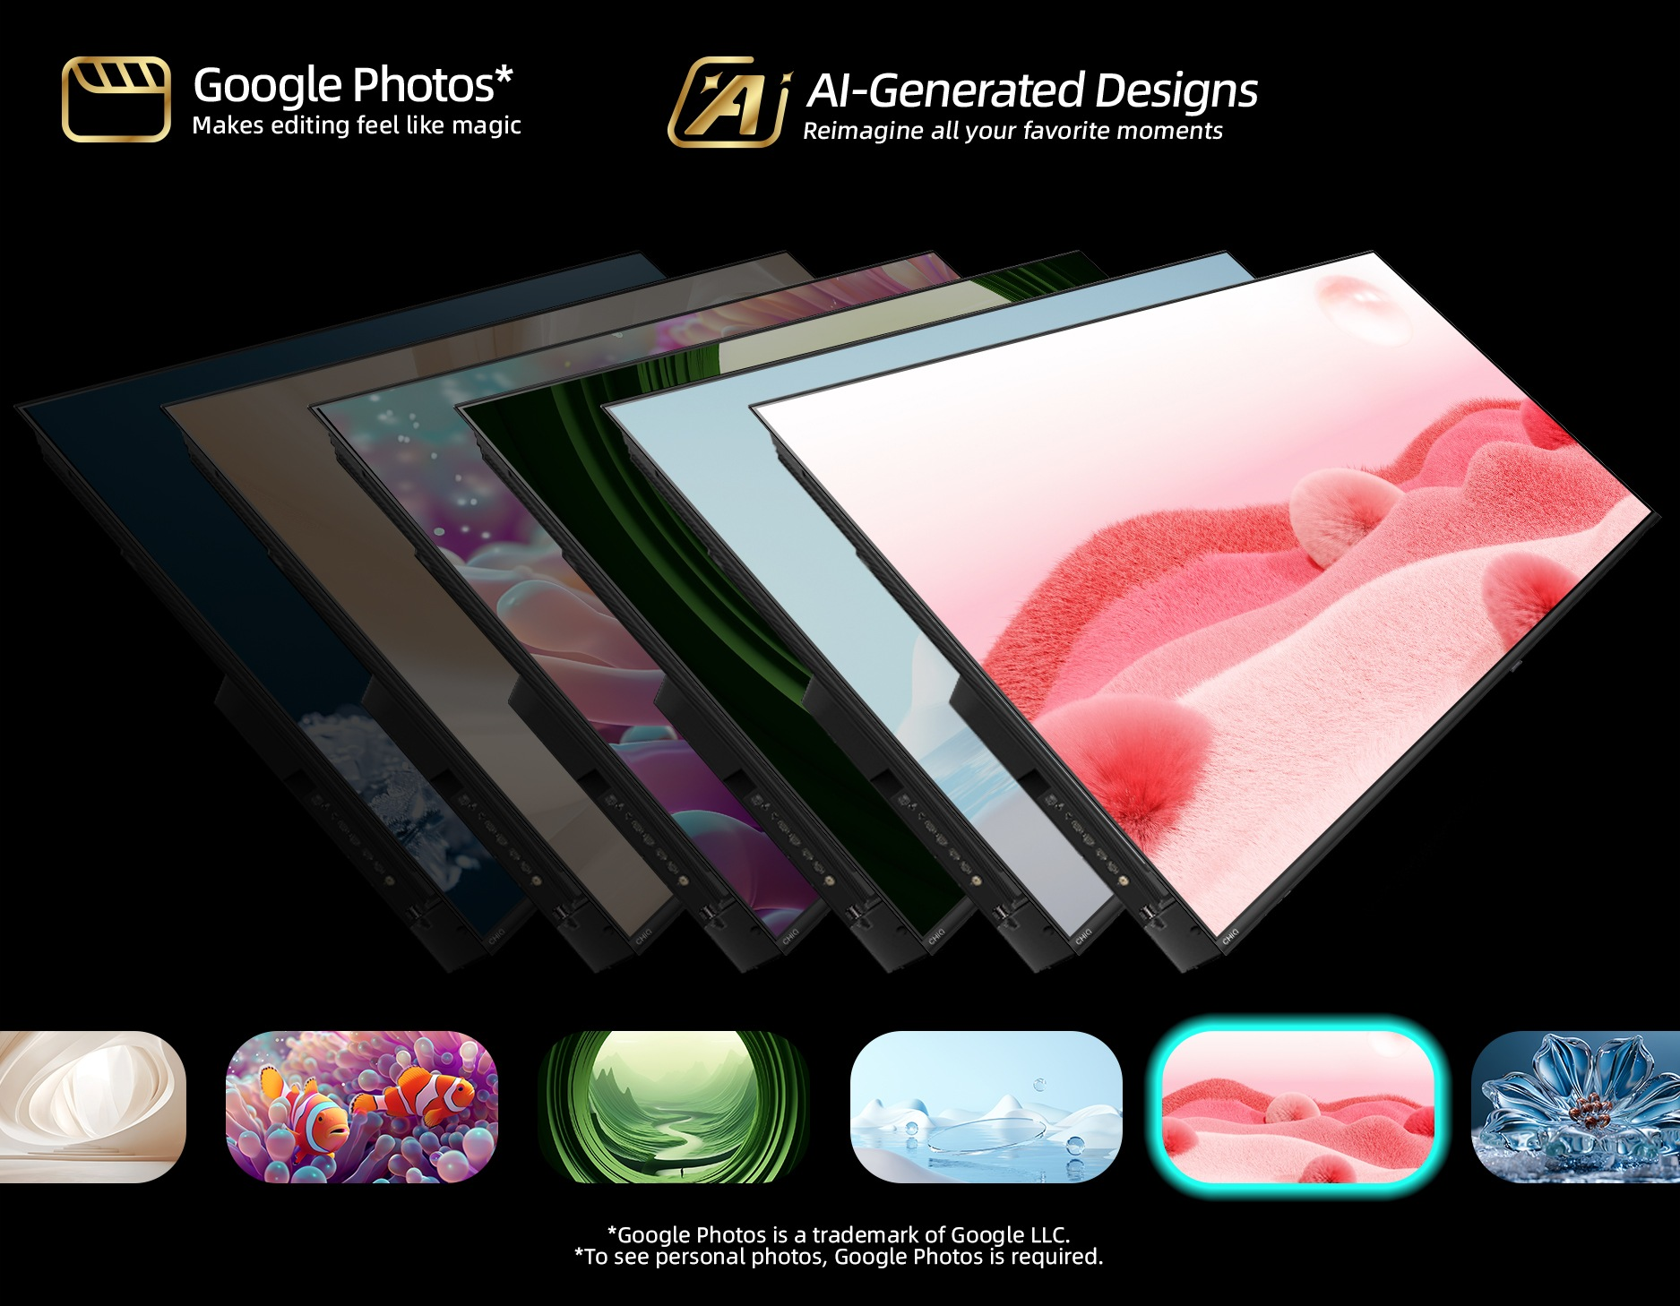
艺术性
长虹·美菱国际区
Personal Masterpiece on the Screen
Personalize your Home Screen. An improved Ambient screensaver lets you create AI-generated designs or relive your favorite moments with Google Photos.— it’s your call.
个性化你的主屏幕。经过改进的环境屏幕保护程序可让您创建人工智能生成的设计，或通过 Google Photos 重温您最喜爱的时刻。

Slide 16
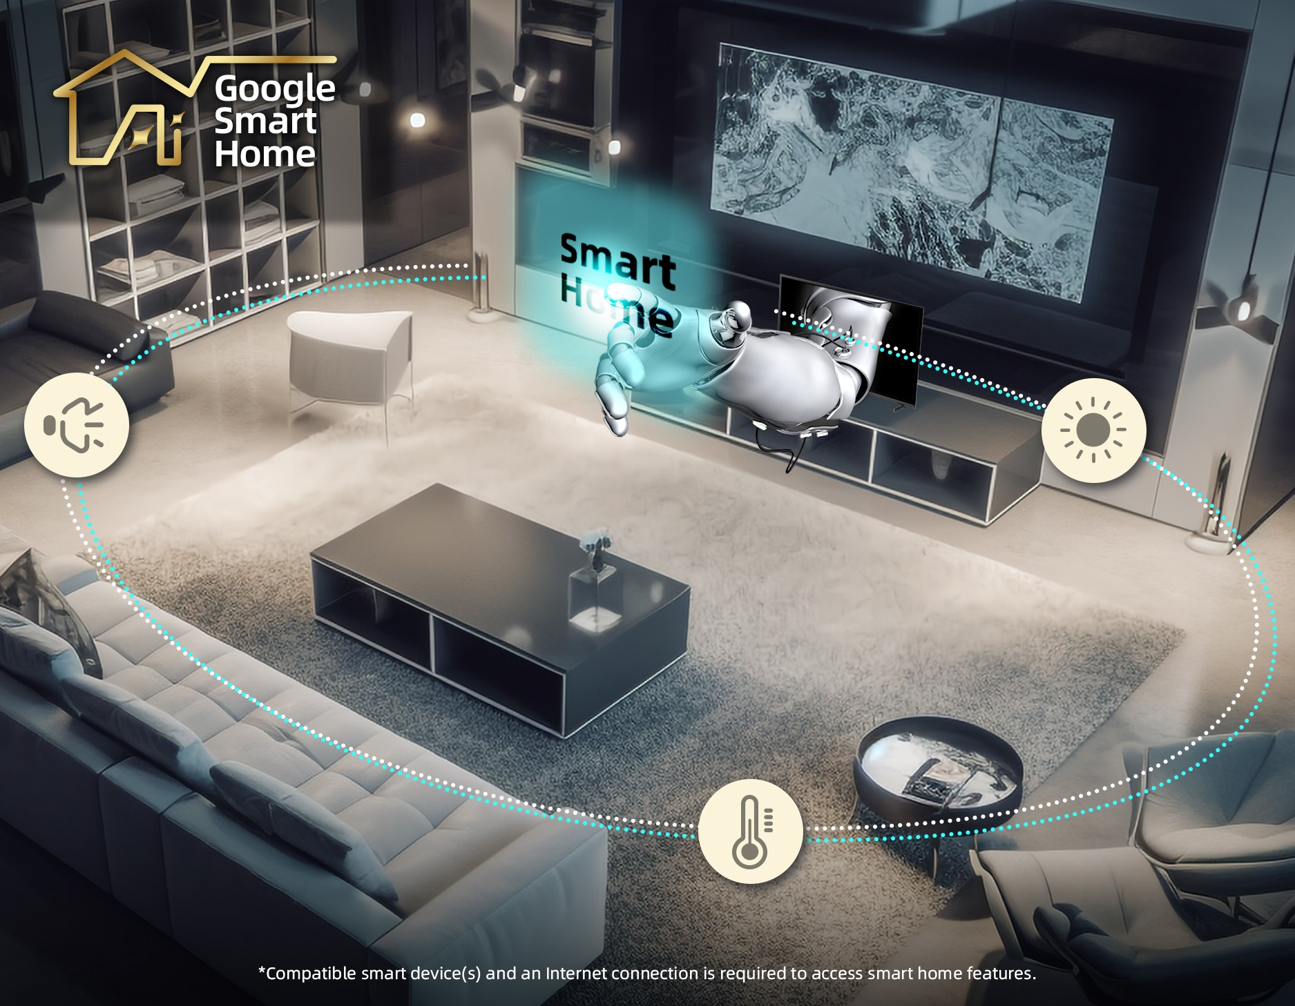
Google Smart Home
长虹·美菱国际区
Make TV the Center of Your Smart Home
Control lights, temperature, get doorbell notificaions and full-screen views of your cameras， and more - all from the comfort of your couch.
在舒适的沙发上就能控制灯光、温度、获取门铃通知和摄像头的全屏视图等。

Slide 17
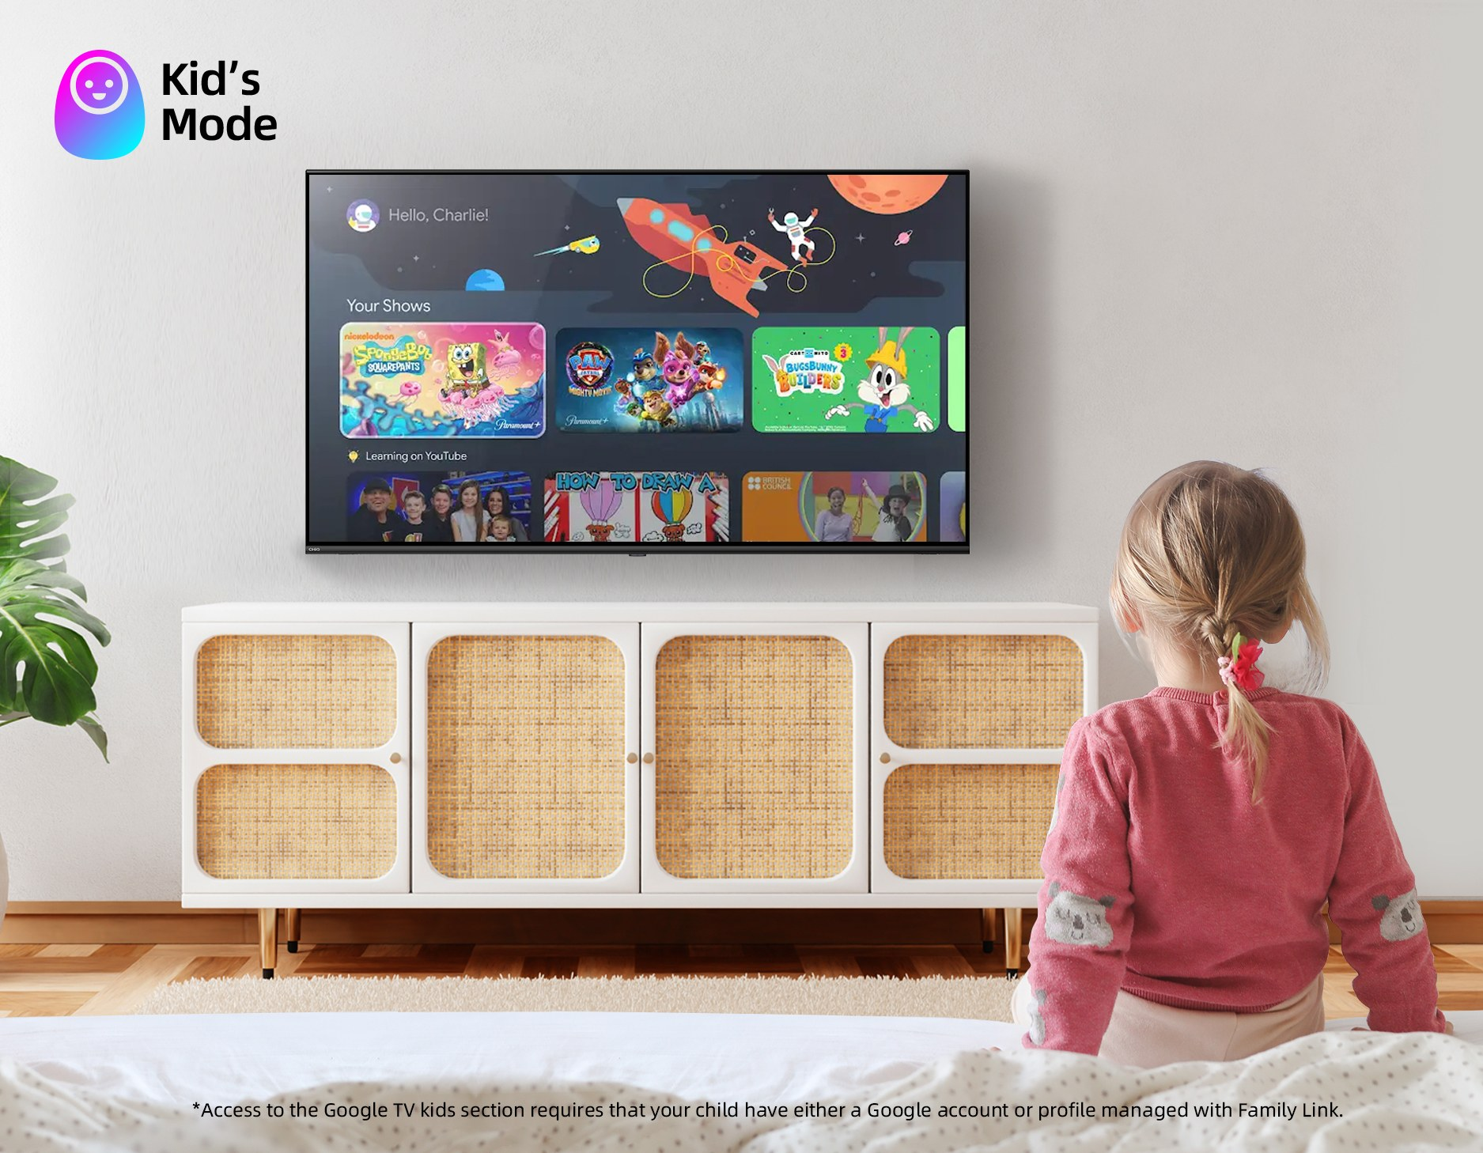
儿童模式
长虹·美菱国际区
Kid’s Mode
激活儿童档案，解锁有趣的儿童友好内容，让您的孩子沉浸在家长无忧的数字乐园中，远离潜在的有害内容。
Activate the Kids Profile to unlock fun, kid-friendly content. Immerse your kids in a parent-free digital playground with less potentially harmful content.

Slide 18
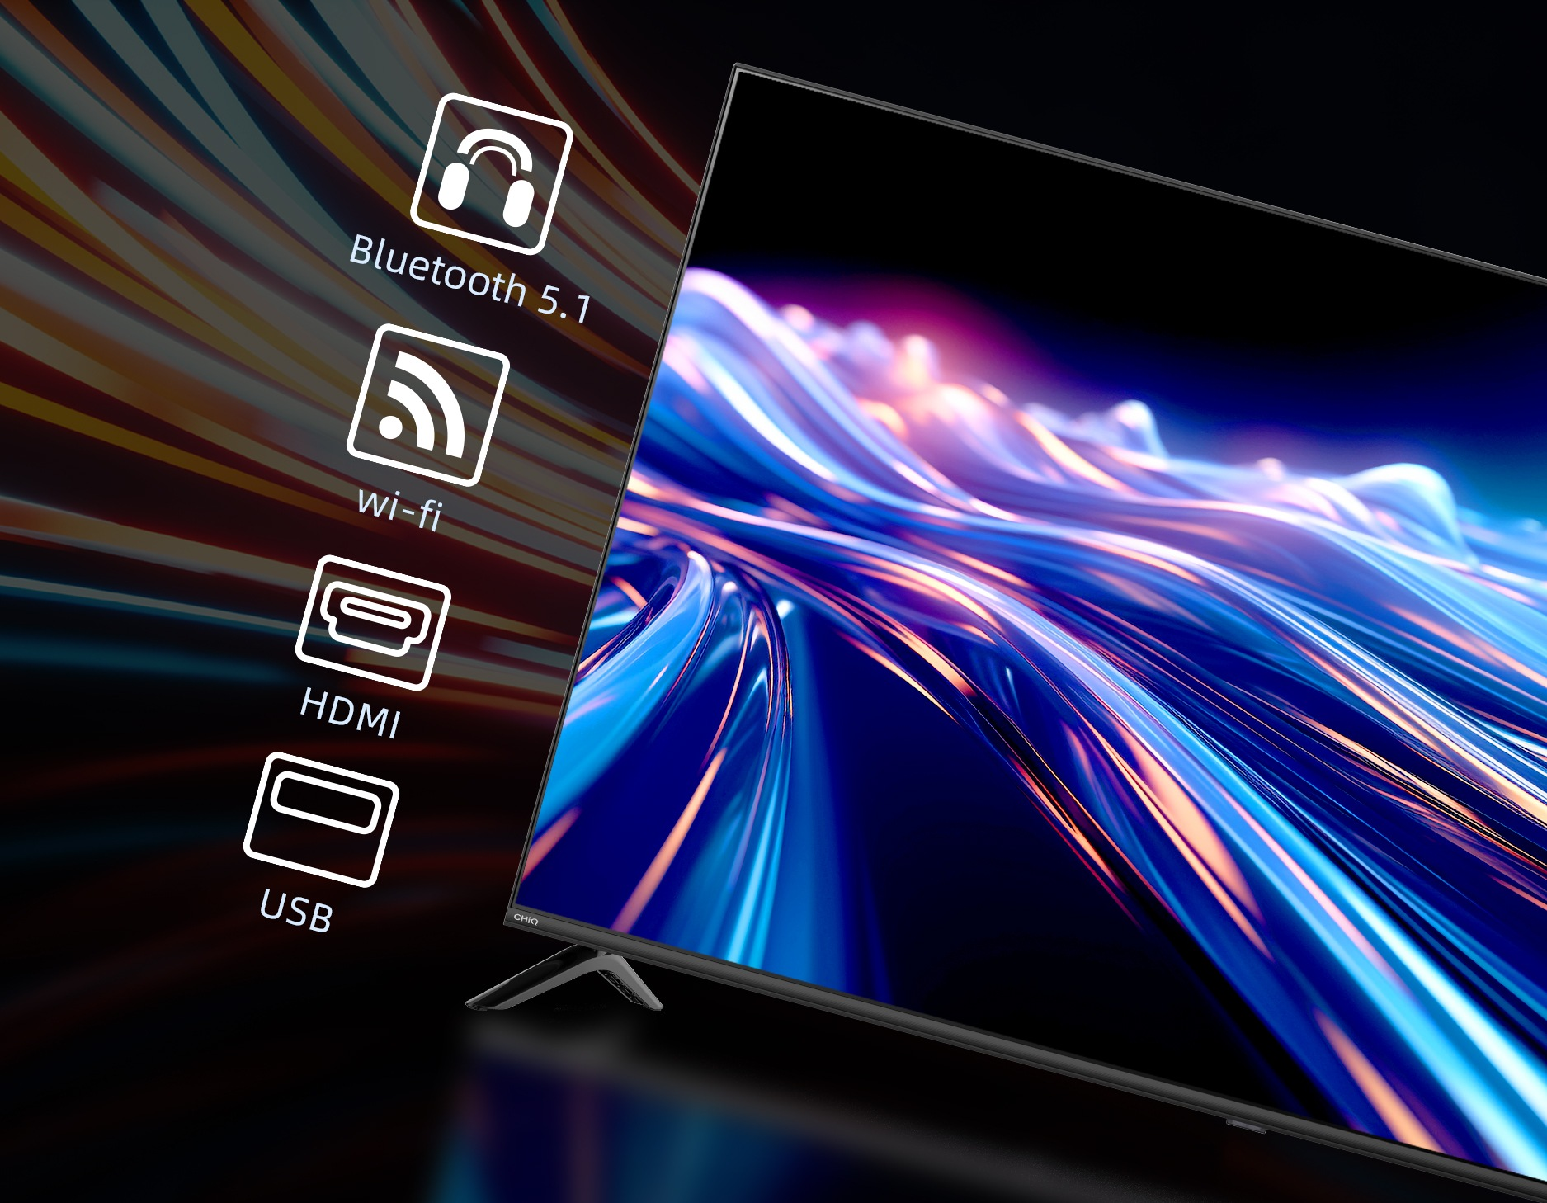
连接
长虹·美菱国际区
Pro ports, pro connection
There is more you can do. CHiQ TV has HDMI ports, USB slots, Dual-Band WI-FI and Bluetooth 5.1. You can connect more devices and external sources to your TV such as game consoles, USB, stereos, etc. Expand multiple scenarios all on one screen.
您还可以做更多。CHiQ TV 拥有 HDMI 端口、USB 插槽、双频 WI-FI 和蓝牙 5.0。您可以将更多设备和外部资源连接到电视上，如游戏机、USB、音响等。在一个屏幕上扩展多种应用场景。

Slide 19
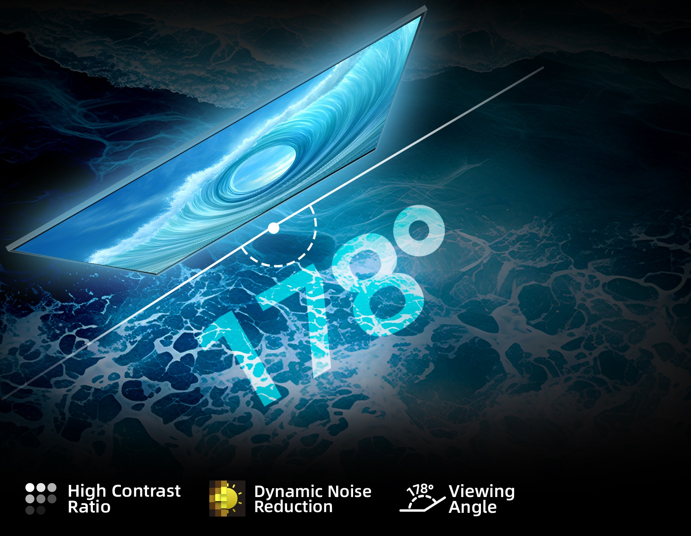
观看角度
长虹·美菱国际区
Here. There. And everywhere.
See vibrant colors and sharp contrasts, whether you're front and center or off to the side.

Slide 20
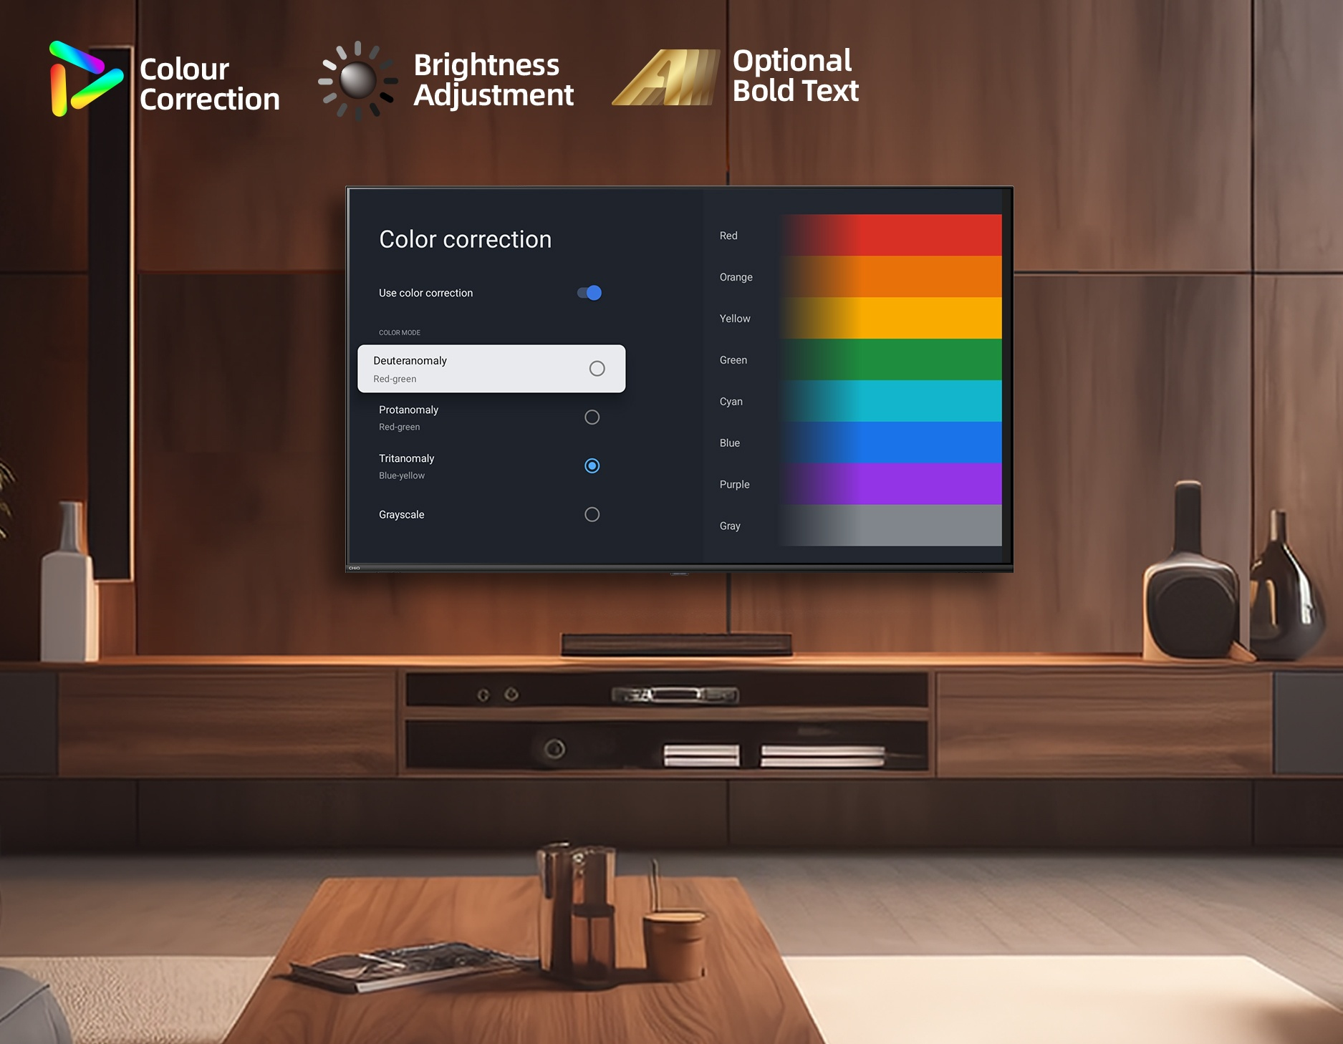
关爱
长虹·美菱国际区
Exceptional Care
Customised colour correction, brightness adjustment, optional bold text for optimal visual experience.
自定义色彩校正、亮度调整、可选粗体文字，带来最佳视觉体验。

Slide 21
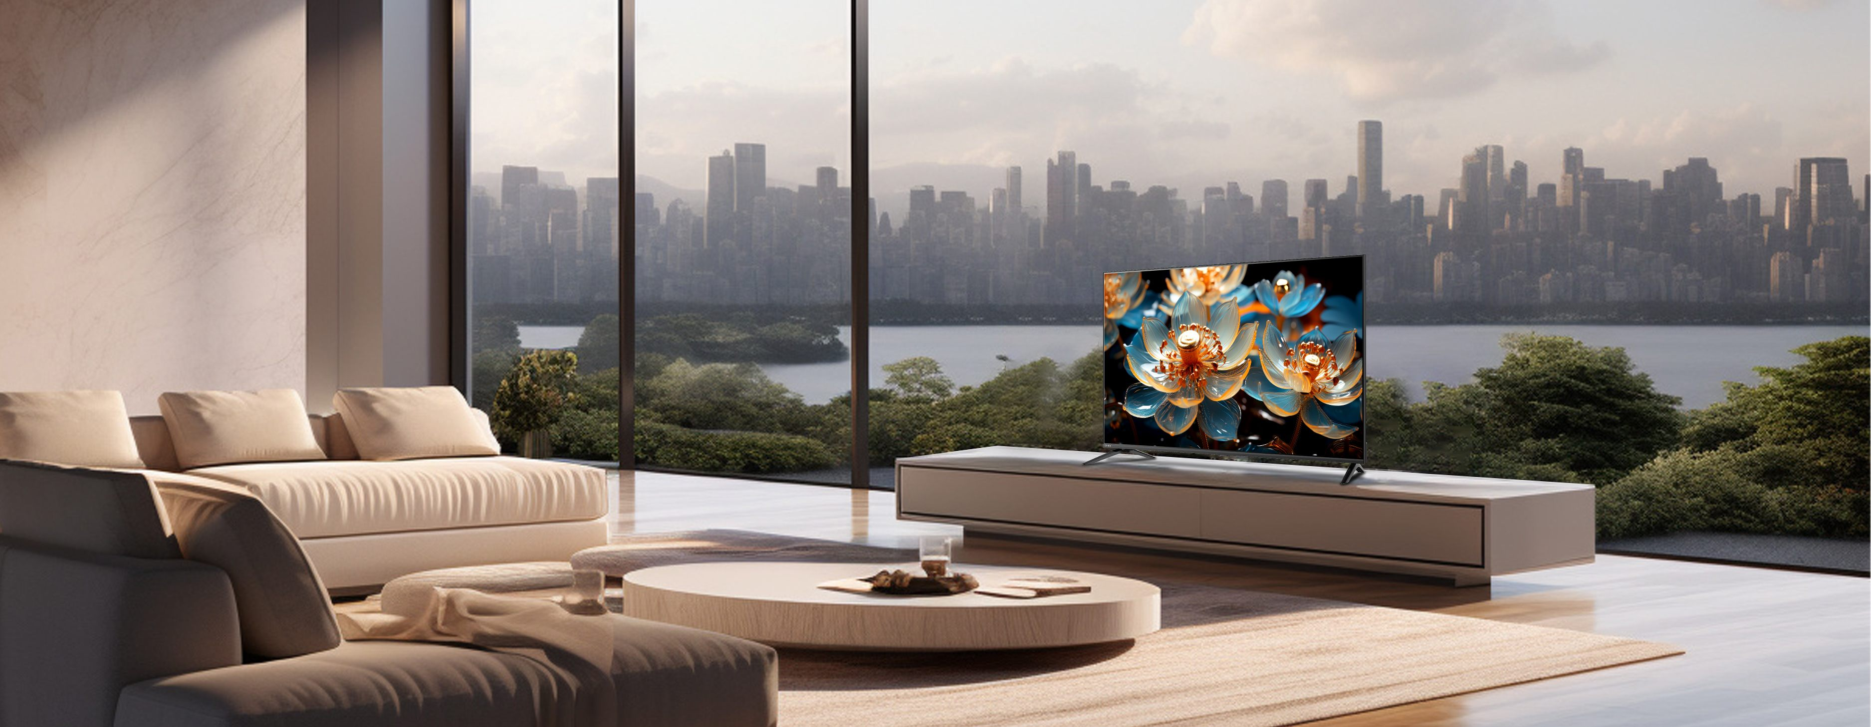
场景图
长虹·美菱国际区

Slide 22
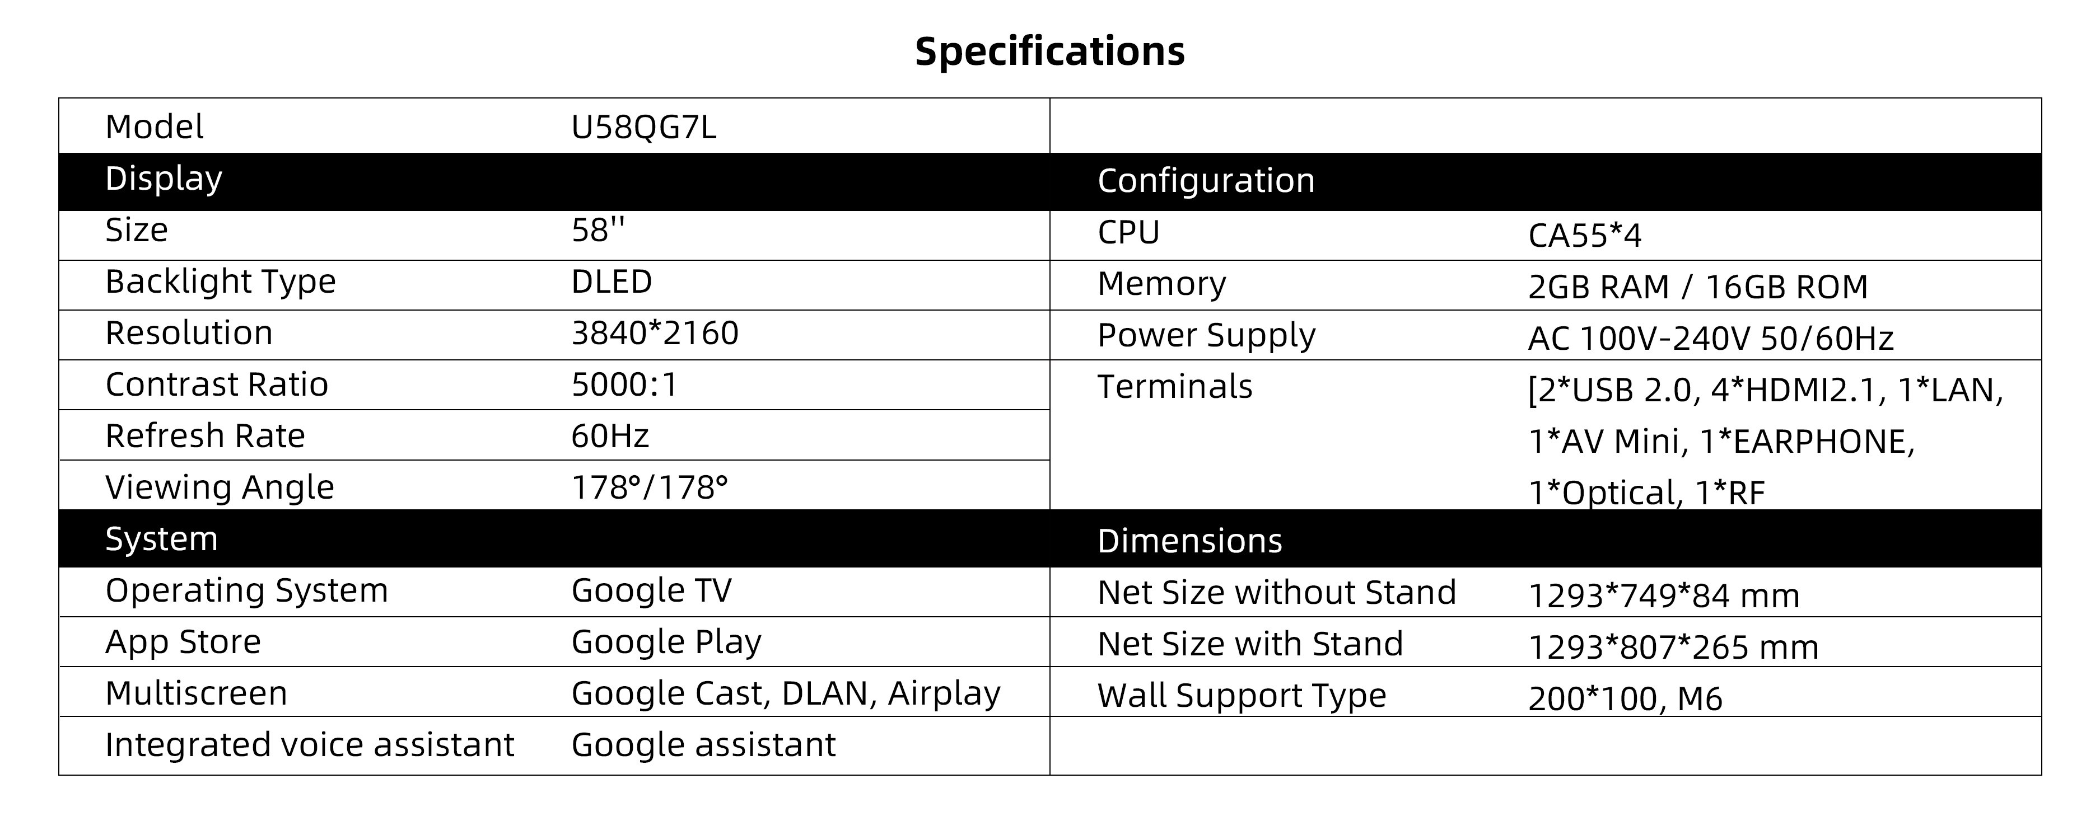
尺寸图
长虹·美菱国际区
Model | U58QG7L
Display |  | Configuration
Size | 58'' | CPU | CA55*4
Backlight Type | DLED | Memory | 2GB RAM / 16GB ROM
Resolution | 3840*2160 | Power Supply | AC 100V-240V 50/60Hz
Contrast Ratio | 5000:1 | Terminals | [2*USB 2.0, 4*HDMI2.1, 1*LAN, 1*AV Mini, 1*EARPHONE, 1*Optical, 1*RF
Refresh Rate | 60Hz
Viewing Angle | 178°/178°
System |  | Dimensions
Operating System | Google TV | Net Size without Stand | 1293*749*84 mm
App Store | Google Play | Net Size with Stand | 1293*807*265 mm
Multiscreen | Google Cast, DLAN, Airplay | Wall Support Type | 200*100, M6
Integrated voice assistant | Google assistant
Specifications

Slide 23
Thank You
长虹·美菱国际区

