Slide 1

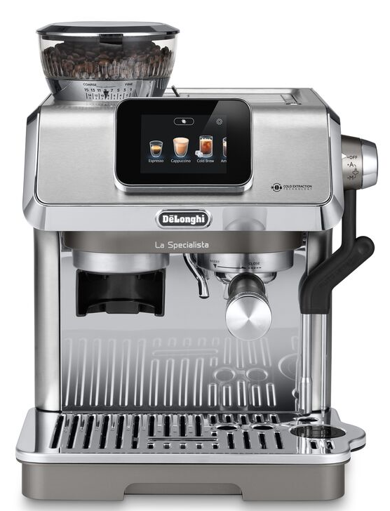
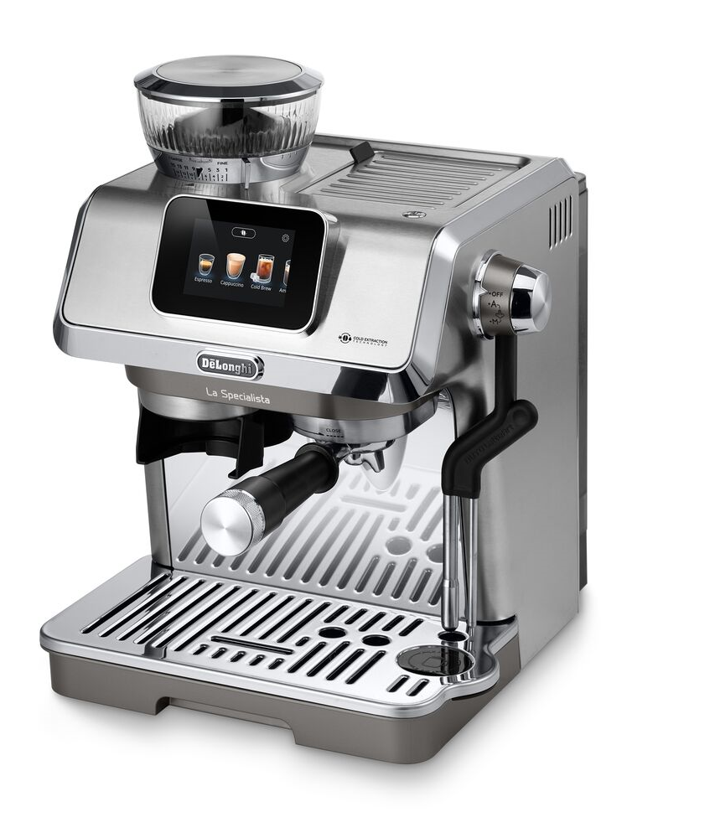


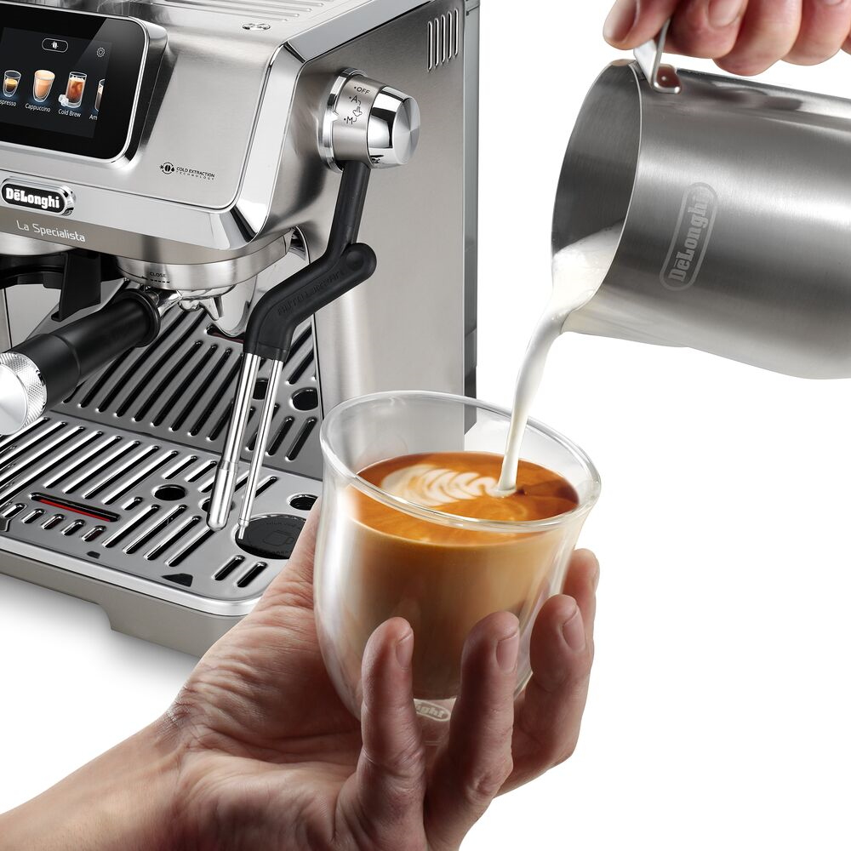
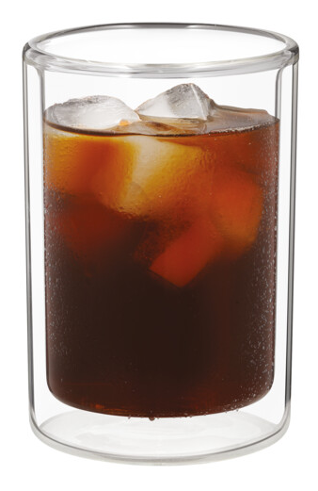

EC9455.M
De’Longhi Coffee
PUMP DRIVEN ESPRESSO MAKER
-
GUIDED COFFEE CRAFTING
VARIETY: HOT & COLD BEVERAGES
MILK VARIETY WITH EASE
3.5 Touch display guides users in every step to make amazing coffees and cappuccinos.. Bean Adapt technology ensures to get the best flavour from the coffee beans.
With the new Cold Extraction Technology, you can enjoy, not only hot beverages (Espresso, Cappuccino and more..) but also Café quality Cold Brew at home anytime you like, in less than 5 minutes.
The new Auto LatteArt System brings the joy of crafting your perfect milk drink right to your fingertips. With two frothing modes—manual for those who love hands-on creativity and automatic for effortless perfection—it takes the guesswork out of every cup. Whether you're using plant-based or dairy milk, it froths to the ideal temperature, offering four precise profiles. From delicate Latte Art to rich, dense foam, you can create five unique textures, all at the touch of a button.
Advanced Thermoblock heating system: for faster machine heat up time and great temperature stability.
Integrated grinder with up to 15 grinding settings.
Cold Extraction Technology: for cold brew
3.5” Touch display for easy guidance
Single wall Filter baskets (1 or 2 cups): coffee dose up to 20g.
10 pre-set recipes: Espresso, Americano, Long Black, Cold Brew, Cappuccino, Latte Macchiato, Latte Flat White, Hot Milk, Hot water.
4 Infusion Temperatures (90/92/94/96°C)
Dosing &Tamping guide for mess free operation and perfect tamping.
Advanced Tamper with dose level indicators.
15-bar pump
Auto LatteArt System: Automatically froths the milk for maximum convenience and quality.
4 milk temperature profiles and 5 milk texture profiles.
Hot water dedicated outlet for teas and infusions
Espresso cup support to maintain a perfect crema
Hots cups and mugs up to 11cm tall.
Removable 1,7L water tank
Accessories: Milk jug, Dosing&Tamping guide, Advanced Tamper , Dose Adjust, Tamping Mat, Steam Wand cleaning tool, 2 filter baskets (1-2 cups).
La Specialista Touch grants a pleasant and guided experience to craft the perfect espresso and milk drinks with ease.
The new Auto LatteArt system is designed to create your favourite foam without any effort.
Select between 4 milk temperature profiles (55/60/65/70° C) and 5 milk texture profiles (from fine to Latte Art and dense)
La Specialista Touch comes with a series of tools to elevate your coffee ritual at home, letting you craft each cup with: the new tamper with dose level indicators, the Tamping Mat, Dosing &Tamping Guide, Dose Adjust, Milk jug, 2 single wall filters (single and double sose).
The Dosing&Tamping guide delivers a 100% mess free operation when grinding and guides to a precise tamping, consistently over time.
Now also featuring brand new Cold Extraction Technology which allows to deliver café quality Cold Brew at home, in under 5 minutes.
TECHNICAL DATA |  | EC9455.M
Rated voltage/Frequency | V~Hz | 220-240 50Hz
Power - Max | W | 1450W
Pump pressure | Bar | 15
Weight | Kg | 10.8 Kg
Dimension (wxdxh) | mm | 319x367x400
Barcode and codes

